Slide 1
ALLOWAH & NDIS presented by Maura Hanney 28th March 2017

Slide 3
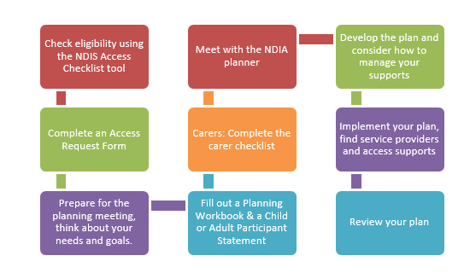
NDIS PROCESS

Slide 4
CONTACT NUMBER FOR NDIS
IF YOU HAVE NOT HEARD FROM THE NDIS or HAVE ANY QUESTIONS, CALL THIS NUMBER
1800 800 110

Slide 5
ALLOWAH’S NDIS APPROVED SERVICES
Help with PRE-PLANNING for the meeting with a Local Area Coordinator (LAC)
SHORT TERM ACCOMMODATION SERVICES. These are commonly known as respite services and include:
Sleep overs which are fun for children and give parents a night off
Weekends away giving parents a break knowing that their child is being well cared for
Regular stays for respite and recreation throughout the year
Crisis accommodation can be provided as required
SCHOOL HOLIDAY RECREATION PROGRAMS for children in the school holidays
AFTER SCHOOL CARE
LONG TERM ACCOMMODATION for children who require additional care
THERAPY SERVICES including occupational therapy, speech therapy, physiotherapy and assistance from a therapy assistant
DIETITIAN for assistance with nutrition
SUPPORT COORDINATION to help you understand your plan and find services for your child

Slide 6
PRE PLANNING HELP
This service is currently a free service provided by Allowah. The pre-planner will help you understand the NDIS application process and document your child’s needs for your planning meeting. You can choose to have the pre-planner attend your planning meeting with you for support.

Slide 7
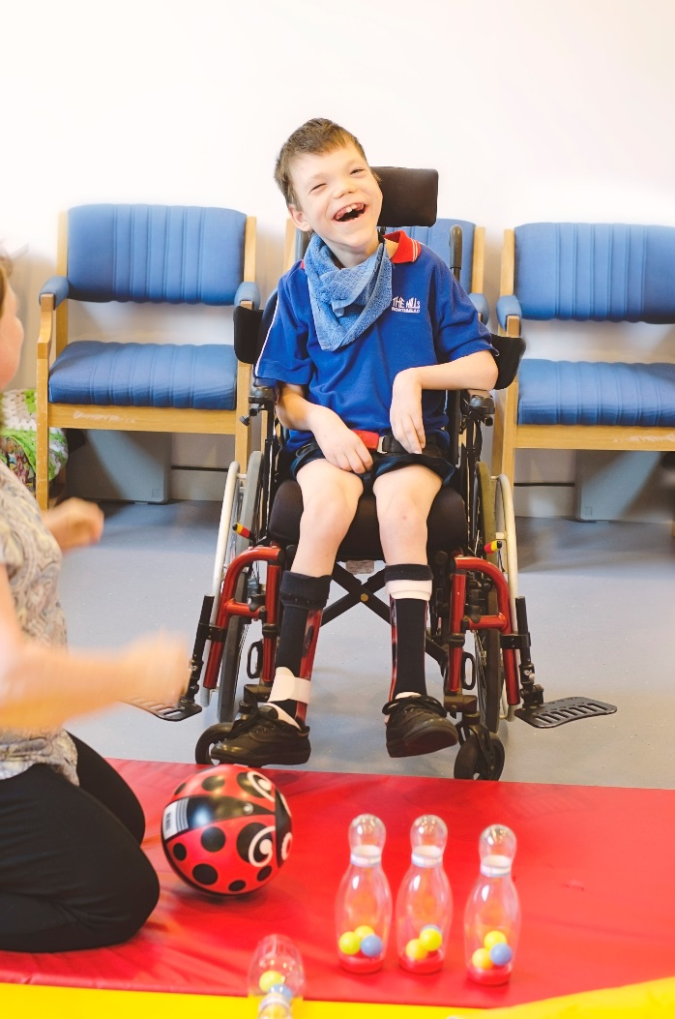
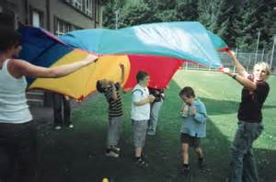
RESPITE/ Accommodation
Allowah specialises in helping children with complex needs to live as full a life as possible.
There are experienced nurses available to care for children with medical needs.
Recreation staff provide activities for all the children.
School holiday, after school care and accommodation programs provide recreation for all children

Slide 8
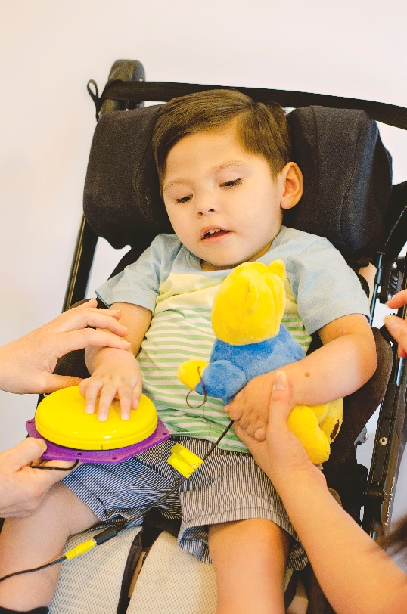
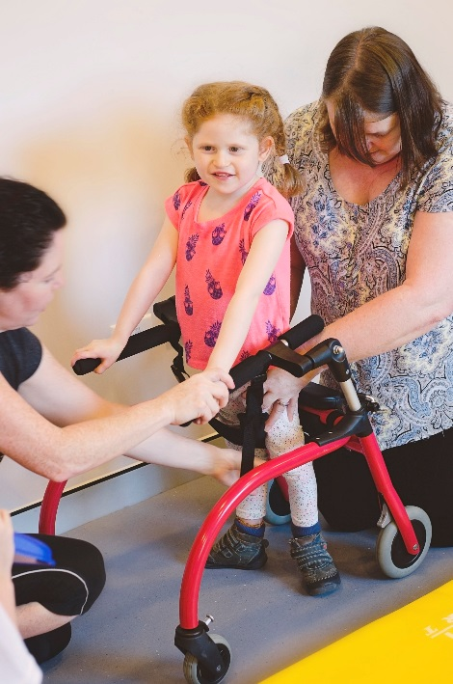
THERAPY SERVICES
EARLYINTERVENTION & THERAPY SERVICES
OT, Physio and Speech Therapy for children with disabilities under the age of 18.
Children can be seen at home, school or in the clinic
A therapy assistant is available to provide practice of the child’s program at Allowah
Occupational therapists and physiotherapist can provide assessment and prescription of equipment for children. They will write reports for NDIS to support the purchase of necessary equipment.
Ask for a report from the therapists to support your planning.

Slide 9
DIETETICS
Children with special needs often require regular assistance from a dietitian to promote healthy growth and development.
The Allowah dietitian is experienced in assessing and meeting the needs of your child.

Slide 10
SUPPORT COORDINATION
Support Coordination can be added to a child’s plan particularly if their needs are complex or the plan is difficult to understand.
The funding can be used to choose a coordinator from any service.
The Allowah Support Coordinator has experience and an understanding of children of all abilities.
The coordinator will talk to you about your plan and help you to put it into action.
If there are any difficulties with finding services for your child, the support coordinator will help you with sorting out the problems.

Slide 11
Contact allowah
Maura Hanney
Manager Disability Services/ Physiotherapist
88773400
physio@Allowah.org.au

