Slide 1

Paediatric Fall and Entrapment Prevention and Management
March 2021
Notes:
This slide deck has been developed as a train the trainer presentation. Notes have been included throughout the presentation to provide context and key messages to emphasise. You are able to amend this slide deck to your local context.

Slide 2


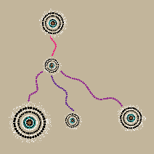



Health Custodian
by Jasmine Sarin
This artwork has been commissioned by the CEC. It is called ‘Health Custodian’ and was created by Jasmine Sarin. Jasmine is a proud Kamilaroi (kuh-mi-luh-roy) and Jerrinja (jer-in-ja) woman from New South Wales.
Acknowledgement of Country and Elders
Before we begin, I would like to acknowledge the traditional owners of the land where we meet today.
I pay my respects to their Elders past and present. It is upon their lands that this building is built.
Notes:
Educator: Welcome to country

Slide 3

Introduction by NSW Chief Paediatrician, Dr Matthew O’Meara
Notes:
Educator: Play video
**Video transcript**
When children are in our care, we are responsible for their safety. In hospital they can fall or become entrapped in the bed or bedding.
Harm resulting from a fall or entrapment is rare in hospital, however the consequences may be serious injury, or even death.
We can make hospitals safer by identifying the risks of falls and entrapment and taking action.
Looking through a child’s eyes, a hospital is very different to home. The beds are higher, there are bed rails that are hard to work out, the floors are harder, there’s lots of things to get tangled in like iv lines and monitors, and you’re often not at your best because of an illness or injury or medicines.
From a parent’s perspective everything is so unfamiliar. Parents are exhausted, worried and distracted. It’s not surprising that many parents don’t even think that their child can fall in a hospital. Most parents don’t remember being told about the risk that their child may fall while in hospital. They don’t know that most falls happen when a parent or carer is present.
For clinicians, that tells us what we need to do. We need to talk with parents, carers and children about falls and entrapment.
We need to talk about how to identify risks. We need to talk about what to do to reduce those risks – what we do for every child, and the extra things that some children need.
And we need to share those strategies with our colleagues through handovers and huddles.
To keep every child safe.

Slide 4

Session outline:
Patient story
Our aim
Who does the guideline apply to?
Fall and entrapment definitions
Why does this matter?
What is the data telling us?
Identifying children at risk of a fall and/or entrapment
Fall and entrapment prevention strategies
Notes:
Slide provides outline of key topics to be covered in this education slide deck, specifically in relation to the Paediatric Fall and Entrapment Prevention and Management Guideline released in October 2020

Slide 5
Coronial inquiry and recommendations
A 13 year old girl with a profound neurological and physical disability unexpectedly died after she fell from a hospital bed and her t-shirt caught on the edge of the bed, resulting in her strangulation.
The Coroner found there was a:
Failure to select an appropriate bed based on the patients needs and risk
Lack of available guidelines on fall and/or entrapment
Recommendation: Develop a guideline directed to improving the safety of beds used by children.
A - point where patient fell from bed
B- anchor point for T-shirt
Notes:
Key Points:
The Paediatric Fall and Entrapment Prevention and Management Guideline was developed in response to recommendations made by the Coroner’s Court of NSW
This is following a case where a 13yr old girl with profound disabilities fell from a hospital bed and her t-shirt became caught on the edge of the bed which subsequently strangled her.
The coronial investigation found that there was a:
Failure to select an appropriate bed based on the patients needs and risks
Lack of available guidelines on fall and/or entrapment
Recommendation was made to develop guidelines that include how to conduct a thorough assessment, taking into consideration a child’s mobility, to determine their risk of entrapment, entanglement, fall or injury.

Slide 6

CEC Paediatric Fall and Entrapment Prevention and Management Guideline
October 2020
Guideline can be found via the CEC website:
https://www.cec.health.nsw.gov.au/keep-patients-safe/falls-prevention/paediatrics
Notes:
Key Points:
The guidance provided in this presentation comes from the CEC Paediatric Fall and Entrapment Prevention and Management Guideline developed in response to the coronial recommendations. It was published on the CEC website in October 2020
It is supported by the Paediatric Cot and Bed Allocation Guide and the Post Fall Guide which are also available via the website
A number of other resources including parent fact sheets and posters on fall and entrapment will be also be available via the website in early 2021

Slide 7
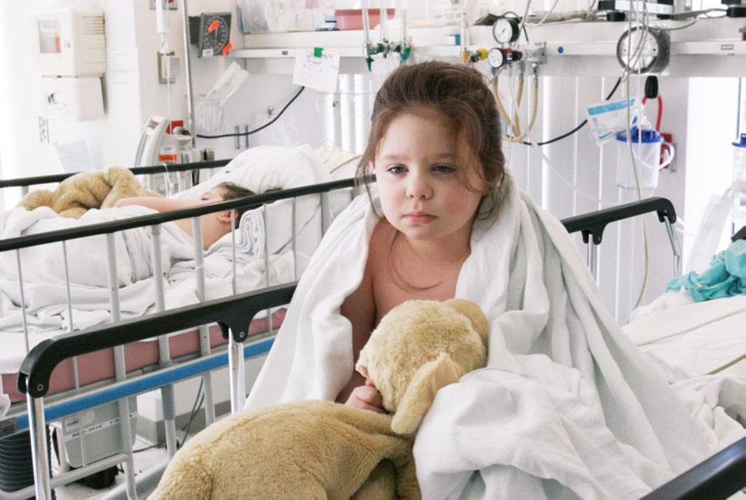
Our aim: To reduce preventable harm associated with a fall and entrapment
Identify
Minimise
Manage
risk of a fall and entrapment
Notes:
Key points:
We all have a responsibility to keep children safe while they are in our care.
Our aim is to reduce the risk of children of all ages falling or becoming entrapped in hospital by identifying, minimising, and managing the individual fall and entrapment risk for babies, children and young people in hospital.
We need to keep in mind that he hospital environment is different from home. The beds are higher, floors are harder and children and families are often not familiar with hospital equipment such as IV poles, crutches and IV lines.

Slide 8
Who does the guideline apply to?
This guideline applies to all staff who deliver care to infants, children and young people in a NSW public hospital
Notes:
Key Points:
The purpose of this guideline is to provide paediatric specific fall and entrapment prevention and risk mitigation guidance for Local Health Districts (LHD) and Specialty Health Networks (SHN).
This guideline applies to all staff who deliver/are responsible for care delivery for infants, children and young people in any NSW public hospital.
It is directed at paediatric inpatient wards and the outpatient areas in the hospital a child may attend whilst an inpatient (such as radiology, physiotherapy etc.) It does not directly apply to an outpatient or community health context. This is because the NSW Paediatric Falls Risk Assessment Tool is only validated in an inpatient context.
NOTE: the falls risk assessment tool is not validated for use in neonatal or paediatric intensive care units.
However, many of the principles and strategies can be applied in a number of settings

Slide 9
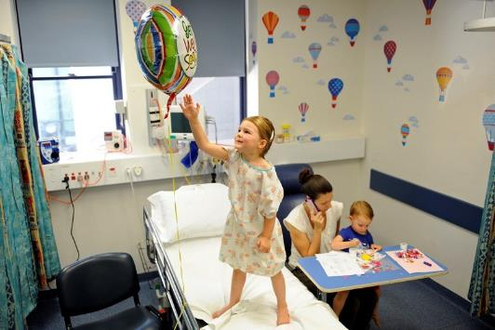
Fall
Definition
An unintended event resulting in a person coming to rest on the ground/floor or other lower level (witnessed) or reported to have landed on the floor (unwitnessed).
This can be from standing, bed, cot or chair.
(World Health Organization, 2018)
Notes:
Key Points:
This is the definition as set by the World Health Organization
Definition is challenging to apply to paediatric context → as part of their development and gross motor skills it is expected children will fall, particularly toddlers and young children

Slide 10
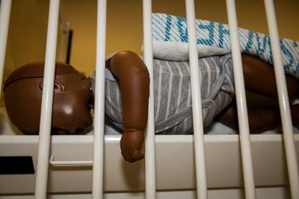
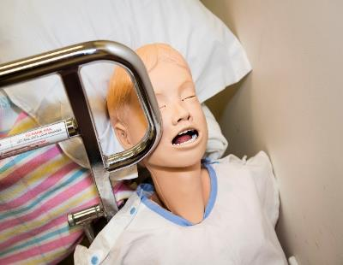
Entrapment
Definition
Incident involving a child’s head or limb being caught, trapped, or entangled in the spaces in or about the bed rail, mattress, or hospital bed frame. Entrapment can result in serious injury or death.
There is NO tool available to determine a child’s risk of entrapment.
You must use your clinical judgement to consider a child’s risk.
Notes:
Key points:
Entrapment can result in serious injury or death.
Incident involving a child’s head or limb being caught, trapped, or entangled in the spaces in or about the bed rail, mattress, or hospital bed frame. Children with impaired mobility (ambulation and/or bed mobility) where the child is unable to reposition themselves independently are at an increased risk of entrapment.
Although rare, the most common situations of entrapment involve wedging between a mattress and a cot side or wall, and hanging.
It is important that a child’s risk of entrapment is considered alongside assessing fall risk.
The NSW Paediatric Falls Risk Assessment Tool does not determine entrapment risk. There is no assessment or screening tool to determine a child’s risk of entrapment. You must use your clinical judgement to consider a child’s risk.

Slide 11
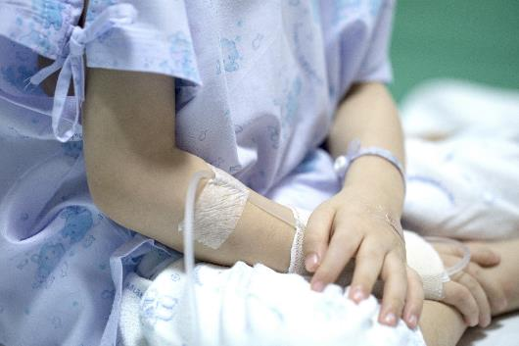
Why does this matter?
Harm resulting from a fall or entrapment is rare in hospital, however, the consequences may be serious injury, or even death.
Within healthcare settings all children are at-risk of falls due to factors including, but not limited to, altered mobility and cognition, medication use and unfamiliar environments (DiGerolamo & Davis, 2017).
Falls and fall-related injuries are of great concern in the healthcare sector due to their negative impact on patient safety (Murray, Vess, & Edlund, 2016).
Notes:
Key Points:
A fall or becoming entrapped can be prevented therefore we have a responsibility to identify risk and implement strategies to help keep children safe in hospital
A fall or entrapment can cause harm. Whilst the occurrence of harm is rare in hospital, when harm is caused it can result in serious injury or death.
In hospital, children are at a higher risk of falling or becoming entrapped. This is due to factors such as altered mobility and cognition, certain medications, generally being unwell and being in an unfamiliar environment.

Slide 12
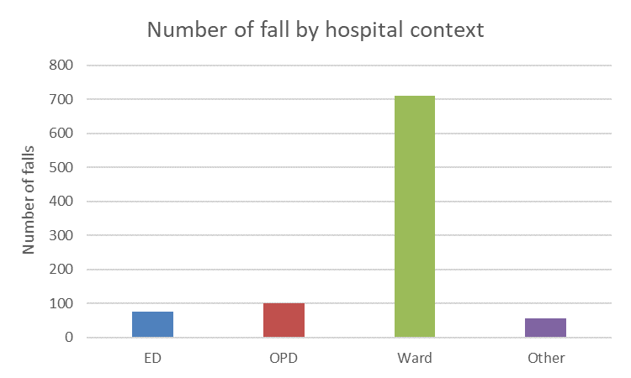
What is our data telling us?
What is the data telling us?
NSW incident data from 2017 – 2019 (inclusive)
Age: 28 days to 16 years
Total of 944 incidents
Notes:
Key Points:
We have looked at the fall incident data from across the state for the 2017 to 2019 period for children aged between 28 days to 16 years
Total of 944 incidents over this time
Most falls occurred on the inpatient wards compared to outpatient departments (OPD) or emergency departments.
Data extracted from IIMS (no IMS+ data included)

Slide 13
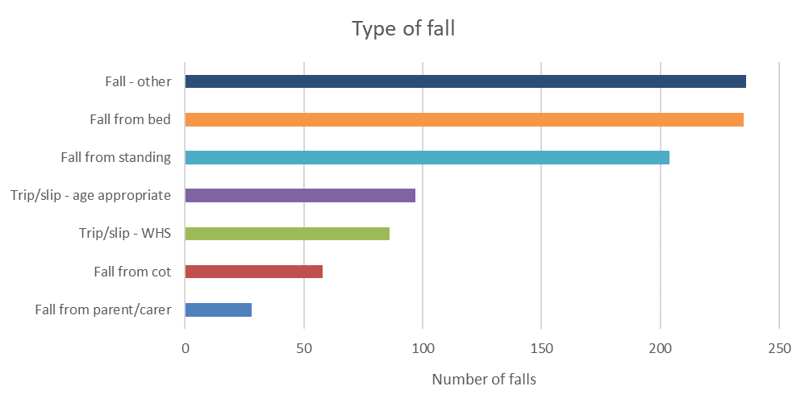
What is our data telling us?
What is the data telling us?
Notes:
Key points:
When looking at the type of fall, falling from bed was the most common
Fall-other incorporates all other falls that do not meet other categories such as a fall from a chair, as a result of climbing over objects or a fall in a ward playroom etc.
A number of falls occurred where the child fell from the parents fold out bed or chair

Slide 14
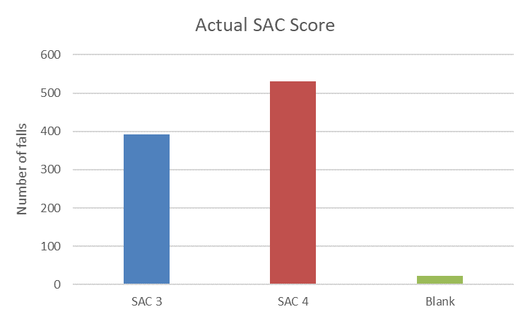
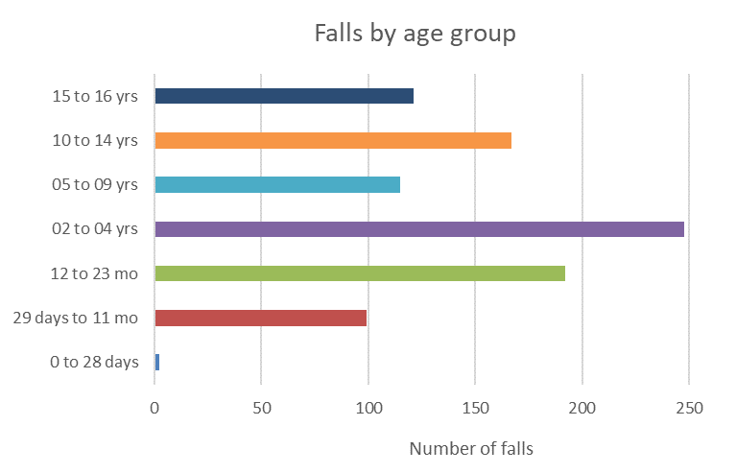
What is the data telling us?
Notes:
Key Points:
No SAC 1 or 2 incidents in the 3 years from 2017-2019. Significant harm from falls in hospital is rare.
The 2-4 years of age is the most common age group to fall however there is a relatively broad spread of falls between the 0-16 years age range.

Slide 15
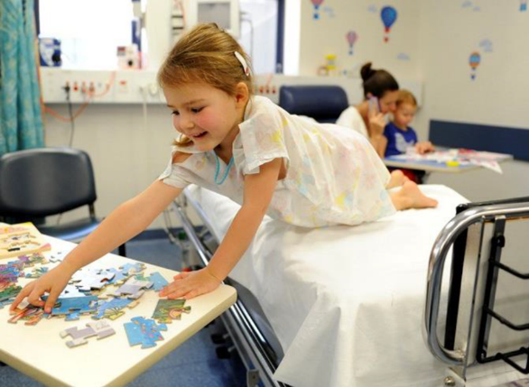
Lessons from our falls data
Many falls occur:
Children under 10 years of age
From beds, cots or fold out parent beds
When standing on beds
When parents are present
Notes:
Key Points:
The majority of incidents involving children younger than 10 years of age are related to falls from beds and cots when parents and carers may be distracted or briefly leave the child unattended.
Majority of falls occur in the care of the parent and family when cot sides are down.

Slide 16

Paediatric Fall and Risk Screening
Falls prevention and management forms part of the National Safety and Quality Health Service Standards - Standard 5: Comprehensive Care.
Screening is a patient safety initiative to prevent and minimise risk of harm.
Screening aims to identify those at risk and employs preventative strategies to mitigate risk.

Slide 17
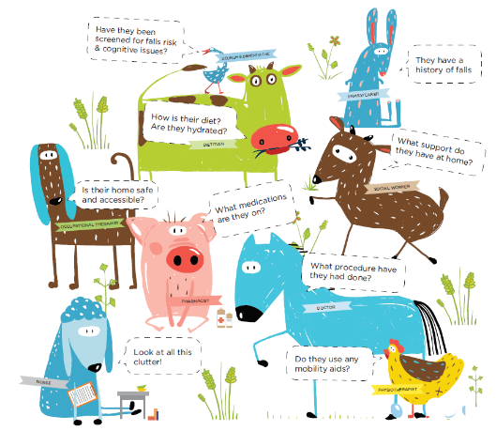

Identifying children at risk of a fall and/or entrapment
Clinicians must use their clinical judgement to determine a child’s risk based on:
Medical condition
Mobility
Age
Staffing levels and skill mix
Notes:
Key Points:
A child’s risk of entrapment is to be assessed in addition to their potential fall risk.
Staff are required to use their clinical judgement to determine a child’s risk of a fall and/or entrapment.
There are a number of factors that influence a child’s risk including:
Medical condition of the child- acute and chronic/long term
Mobility – both ambulation and bed mobility need to be considered
Age
Staffing levels and skill mix
It is essential to consult with the child and their carers when determining the child’s fall and entrapment risk.

Slide 18

Patient story
Notes:
Educator: Play video
**Video transcript**
My 11 month old child was admitted following a minor operation. Whilst she was on the ward she had a fall from her cot. It was really scary. I was standing next to the cot and turned my back for a split second. My daughter fell between the cot and my body landing on her head. Thankfully she didn’t seriously hurt herself. It was so frightening. Harm from a fall was the last thing on my mind when I came into hospital with my child, nor did I know my child was considered a fall risk.

Slide 19

Activity: Can you identify 11 fall and/or entrapment prevention interventions in the next slide?
Notes:
Instructions:
On the following slide there is an image of a hospital ward scene.
Activity: Can you identify 11 routine fall and/or entrapment prevention interventions in the next slide?

Slide 20
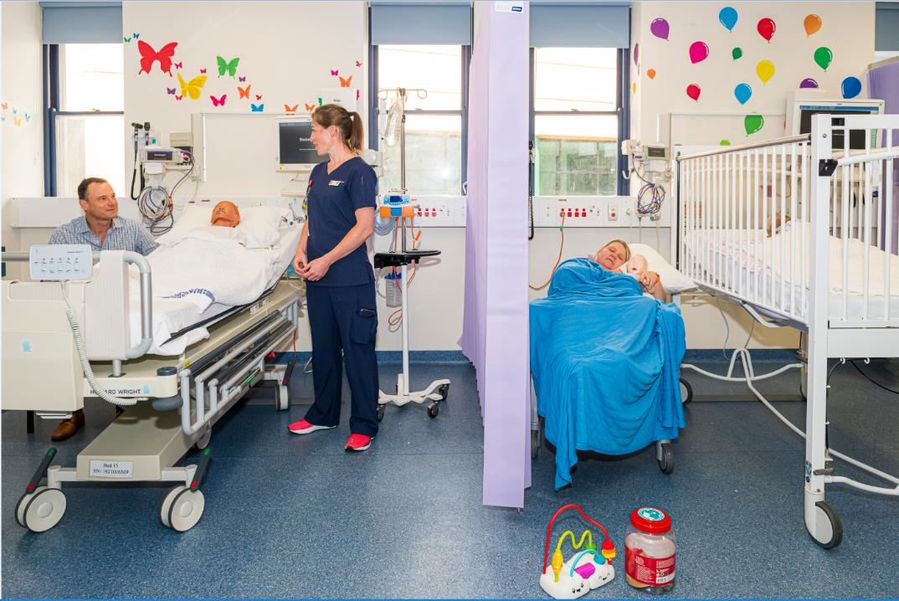
⑦
①
④
⑤
⑨
⑩
②
③
⑪
⑥
⑧
Notes:
Instructions: Identify the routine fall and/or entrapment care actions in the image above – note: there are a number of risks shown as well as recommended preventions strategies in place as outlined in the Paediatric Fall and Entrapment Prevention and Management Guideline.
Educate the child and carers about the potential risk of a fall, interventions to reduce a fall, harm from a fall, and how they can help prevent a fall. Link to fact sheets and posters etc. Orientate child and their carers to the bedspace, i.e. how to control bed and bed rails etc. Assess the child’s and/or carers ability to attend to activities of daily living independently and provide assistance as required.
For children requiring a bed, bed rails are to be placed in the down position unless clinically indicated.
For children who mobilise with an IV pole, place equipment close to the centre of the pole and check IV lines are secure. Note: IV poles should not be used as a mobility aid.
Pull back curtains during the day and ensuring a full view of the child unless otherwise indicated and keep the door to the room open at all times unless specific isolation precautions are in use or as clinically indicated
Ensure the call bell, bed controller and lights are in reach of the patient (age appropriate)
Ensure that bed/cot brakes are on and bed heads and foot ends are in place on all beds where a child is placed
If the child requires a cot, cot rails are to be placed upright in the highest position.
Ensure the environment is clear of clutter and the bed area is clear of trip hazards
Discourage carers from sleeping while holding their child, whilst in a chair or bed
Ensure the child is placed appropriately in a bed or cot based on their developmental needs. Refer to the Cot and Bed Allocation Guide (CaBAG) (Appendix B) for assistance in determining an appropriate bed or cot for the child and use of bed rails:
Discourage children from standing on beds and/or furniture, including carer pull-out beds

Slide 21
Did you identify all 11 interventions?
Educate the child and carers about the potential risk of a fall, interventions to reduce a fall, harm from a fall, and how they can help prevent a fall.
Bed rails are to be placed in the down position unless clinically indicated.
When mobilising with an IV pole, place equipment close to the centre of the pole and check IV lines are secure. Note: IV poles should not be used as a mobility aid.
Pull back curtains during the day and ensuring a full view of the child unless otherwise indicated and keep the door to the room open at all times unless specific isolation precautions are in use or as clinically indicated
Place call bell, bed controller and lights in reach of the patient (age appropriate)
Ensure that bed/cot brakes are on and bed heads and foot ends are in place
Cot rails are to be placed upright in the highest position.
Ensure the environment is clear of clutter and the bed area is clear of trip hazards
Discourage carers from sleeping while holding their child, whilst in a chair or bed
Ensure the child is placed appropriately in a bed or cot based on their developmental needs. Refer to the Cot and Bed Allocation Guide (CaBAG)
Discourage children from standing on beds and/or furniture, including carer pull-out beds
Notes:
Fall and/or entrapment prevention interventions
Educate the child and carers about the potential risk of a fall, interventions to reduce a fall, harm from a fall, and how they can help prevent a fall. Link to fact sheets and posters etc. Orientate child and their carers to the bedspace, i.e. how to control bed and bed rails etc. Assess the child’s and/or carers ability to attend to activities of daily living independently and provide assistance as required.
For children requiring a bed, bed rails are to be placed in the down position unless clinically indicated.
For children who mobilise with an IV pole, place equipment close to the centre of the pole and check IV lines are secure. Note: IV poles should not be used as a mobility aid.
Pull back curtains during the day and ensuring a full view of the child unless otherwise indicated and keep the door to the room open at all times unless specific isolation precautions are in use or as clinically indicated
Ensure the call bell, bed controller and lights are in reach of the patient (age appropriate)
Ensure that bed/cot brakes are on and bed heads and foot ends are in place on all beds where a child is placed
If the child requires a cot, cot rails are to be placed upright in the highest position.
Ensure the environment is clear of clutter and the bed area is clear of trip hazards
Discourage carers from sleeping while holding their child, whilst in a chair or bed
Ensure the child is placed appropriately in a bed or cot based on their developmental needs. Refer to the Cot and Bed Allocation Guide (CaBAG) (Appendix B) for assistance in determining an appropriate bed or cot for the child and use of bed rails:
Discourage children from standing on beds and/or furniture, including carer pull-out beds

Slide 22
High risk care actions
All children assessed to be a high risk of a fall require a fall prevention management plan.
High risk care actions include:
Placing the child in a high observation area, wherever possible
Assessing the need for 1:1 nursing care
Accompanying the child when mobilising for the first time following a procedure and/or when assistance has been specified in the care plan
Checking the child every hour if they are unattended (as a minimum)
Reviewing current medication list and administration times that may contribute to an increased fall risk e.g. frequency of medication to support adequate sleep or rest periods or medications that may affect cognitive function
Where possible, ensuring the bed height is at the lowest possible setting to the ground
Utilising appropriate mobility equipment
Referring to allied health (e.g. physiotherapy, occupational therapy) as required for mobility assessment and equipment recommendations
Notes:
Key Points:
Any child scoring 12 or above on the NSW Paediatric Fall Risk Assessment Tool is at high risk of a fall and must have:
Additional prevention intervention implemented (i.e. in addition to the routine care actions)
A fall prevention management plan clearly documented in their medical record. The plan must outline the fall prevention interventions to be implemented. The plan is to be developed in collaboration with the child (where appropriate) and their carers, and be communicated to staff through multidisciplinary handovers, bedside clinical handovers and safety huddles .

Slide 23
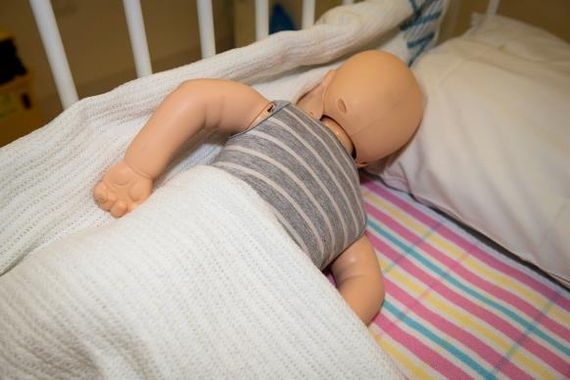

Entrapment prevention strategies
Children at risk of entrapment must have a prevention management plan implemented
Bed rail protectors/bumpers are only to be used if clinically indicated – refer to the Cot and Bed Allocation Guide
Bed rail protectors/bumpers, pillows or excessive blankets are not to be used in cots
Co-sleeping increases the risk of entrapment
For children at high or extreme risk of entrapment, consider placing mattress on floor
Notes:
Key Points:
A child’s risk of entrapment is to be assessed in addition to their potential fall risk. Staff are required to use their clinical judgement to determine a child’s risk of entrapment, in consultation with the child and their carers.
If a child is considered at risk of entrapment, they must have a prevention management plan implement. The plan is to be:
Development and implemented in collaboration with the child (where appropriate) and their carers
Clearly documented in the child’s medical record and communicated to staff through multidisciplinary handovers, bedside clinical handovers and safety huddles.
It is recommended that beds are not routinely fitted with bed rail protectors/bumpers unless staff have determined the child’s potential risk of injury increases in the absence of fitted bed rail protectors/bumpers. Therefore, bed rail protectors/bumpers may be used in certain circumstances, following a risk assessment, to reduce the risk of bed rail protector/bumper entrapment and/or suffocation.
For children who require bed rail protectors/bumpers:
Must be clearly documented in the child’s medical record and communicated to staff through multidisciplinary handovers and safety huddles.
Must be placed in a bed/room that can be closely supervised by staff.
Require close and frequent observation/supervision.
Bed rail protectors/bumpers must be fitted according to the manufacturer’s instructions.
Only use bed rail protectors/bumpers endorsed by the manufacturer of the bed.
Pillows and/or blankets can create a risk of suffocation and should be used with caution
Bed rail protectors/bumpers, pillows or excessive blankets are not be used in cots. They increase the risk of entrapment and suffocation.
Carer’s should not co-sleep with their young children. Co-sleeping increases the risk of entrapment for the child and is not recommended. Refer to NSW Health Policy PD2019_038 – Babies - Safe Sleeping Practices.
For children at high or extreme risk of entrapment, consider placing mattress on floor. This does pose as a potential WHS risk and requires a WHS risk assessment. Seek local guidance.

Slide 24
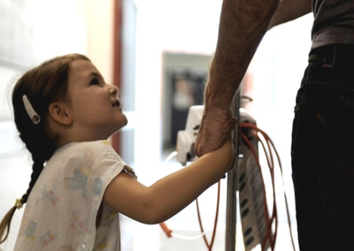
Key prevention principles in preventing a fall and entrapment
Engage the child and their carer in prevention of a fall and entrapment
Identify children at risk
Communicate at clinical handover and safety huddles children at high risk of a fall or entrapment
Develop, communicate and document prevention interventions with input from the child, carer and family.
Notes:
Key Points:
There are 4 simple steps in reducing harm
We need to talk with parents, carers and children about falls and entrapment.
We need to talk about how to identify risks. We need to talk about what to do to reduce those risks – what we do for every child, and the extra things that some children need.
And we need to communicate those strategies with our colleagues through handovers and huddles and
document strategies in a management plan for those patients considered a high risk

Slide 25
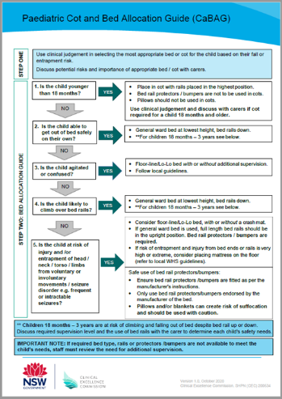
Paediatric Cot and Bed Allocation Guide (CaBAG)
Key points:
Children younger than 18 months should be placed in a cot with the rails in the highest position
If a child is able to get out of bed safely- general ward bed at lowest height, bed rails down
Children 18 months – 3 years are at risk of climbing and falling out of bed despite bed rails up or down. Discuss required supervision level and the use of bed rails with the carer to determine each child's safety needs.
CaBAG is available via the CEC website:
https://www.cec.health.nsw.gov.au/keep-patients-safe/falls-prevention/paediatrics
Notes:
Key Points:
The CaBAG is designed to help staff identify the most appropriate bed or cot for a child based upon their risk of a fall and entrapment.
The are a number of key changes recommended by the CaBAG (supported by the Guideline) including:
Children under 2 years of age should be placed in a cot with the rails in the highest position
If a child is able to get out od bed safely, place in a general ward bed at lowest height with bed rails down
If recommended bed type, rail protectors/bumpers are not available to meet the child’s need, staff must review the need for additional supervision

Slide 26
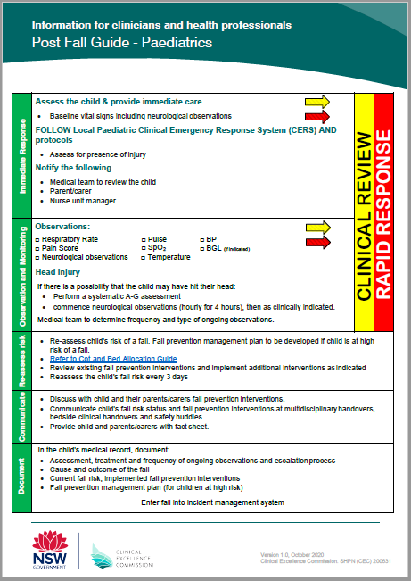
Post Fall Management
Respond immediately
Observations & Monitoring
Re-assess their risk
Communicate
Document
Post Fall Guide is available via the CEC website:
https://www.cec.health.nsw.gov.au/keep-patients-safe/falls-prevention/paediatrics
Notes:
Key points:
Following a fall, it is important to clinically assess the child for injury.
If a child does fall:
An immediate response is required. The local Clinical Emergency Response System (CERS) should be activated to ensure prompt escalation and assessment of the child following a fall.
Undertake observations and monitor the child. Consider observations required if the child hit their head.
Reassess their risk of a further fall. The mechanism of the fall should be assessed with a review of existing interventions. Implement additional interventions as indicated.
Communicate with the child (where appropriate), their carers and staff about the child’s fall risk and prevention interventions. This includes providing the child and their carers with the relevant information such as included in a fact sheet
Document the cause of the fall, treatment, current risk and prevention interventions
It is recommended that the CEC Post Fall Guide be used to guide the post fall care phase and management of a child following a fall

Slide 27
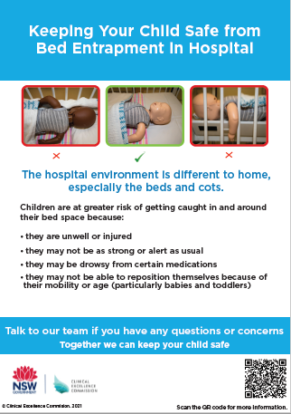
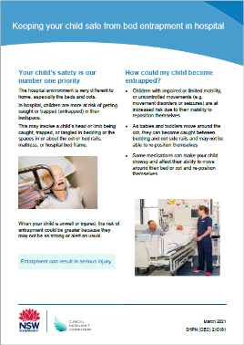
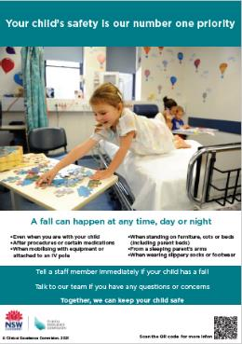
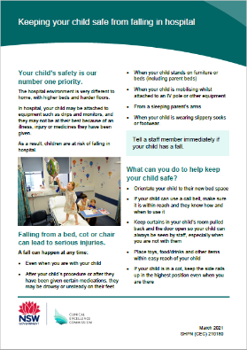
Parent/Carer Information
Posters and facts sheets are available via the CEC website:
https://www.cec.health.nsw.gov.au/keep-patients-safe/falls-prevention/paediatrics
Posters
Fact sheets
Notes:
Key points:
Parent/carer information sheet should be distributed to all parents/carers on admission
A copy of the information sheet can be found on the CEC website OR (LHD to insert local location)
Parents/Carers (and the child where appropriate) must be informed of risk of falls and interventions involved in falls prevention management planning.

Slide 28

Who do I ask for more information?
    At Allowah, you can get more information from our Physio or from the Director of Disability Supports
Notes:
Key Points:
Visit the CEC website or contact the CEC Paediatric Patient Safety Program via email

Slide 29
Bed Allocation
Allowah was involved in developing this resource. However, almost all the children at Allowah will fall into the highest risk assessment category for falls. Therefore we have developed our own Bed Allocation tool to assist reduce the risk of falls for our cohort. For more information about this tool ask the Director of Disability Supports.

Slide 30
Questions?

Slide 31
References
Levene, S. & Bonfield, G. 1991, ‘Accidents on hospital wards’, Archives of Disease in Childhood, vol. 66, no. 9, pp. 1047-9.
Cooper, C.L. & Nolt, J.D. 2007, ‘Development of an evidenced-based pediatric fall prevention program’, Journal of Nursing Quality Care, vol. 22, no. 2, pp. 107-12.
Clinical Excellence Commission. Post Fall Guide - Paediatrics. Sydney: CEC; 2017.
Clinical Excellence Commission. Information for Parents & Carers: Falls Prevention for Children in Hospital. Sydney: CEC; 2017.
The Humpty Dumpty Falls Prevention ProgramTM https://www.nicklauschildrens.org/humptydumpty
Gonzales, J., Hill-Rodriguez, D., Hernandez, L.M., Williams. J.R. & Cordo, J.A. 2016, ‘The Nicklaus Children’s Hopsital Humpty Dumpty Falls Prevention ProgramTM: Preventing falls in children across the globe ‘, Nurse Leader, vol.14 , no. 3, pp. 212-18.
Hendrich, A.L., Bender, P.S., & Nyhuis, A. 2003, ‘Validation of the Hendrich II Fall Risk Model: A large concurrent case/control study of hospitalized patients’, Applied Nursing Research, vol. 16, no. 1, pp. 9-21.
World Health Organization 2008, Children and Falls, WHO, Geneva.
World Health Organization 2008, World Report on Child Injury Prevention, WHO, Geneva.

